Slide 1
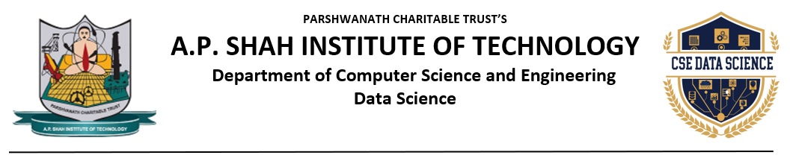
A REAL TIME SIGN LANGUAGE INTERPRETER
Sara Rajpurkar-23107076
Bhumika Nikam-23107009
Rutuja Sawant -23107143
Prajakta Bhanushali-23107057
Project Guide
Ms. Swati Parhad

Slide 2
Outline
Introduction
Literature Survey of the existing systems
Limitations of the existing systems
Problem statement
System Design
Technologies and methodologies
Implementation
Conclusion
References

Slide 3
Introduction
Sign language is a primary mode of communication for hearing-impaired individuals. However, a significant communication gap exists between deaf individuals and people who do not understand sign language. To bridge this gap, we propose a real-time Sign Language Interpreter system that converts hand gestures into readable text and audible speech. The system uses computer vision techniques and deep learning algorithms to detect hand movements through a webcam, process the gesture patterns, and classify them using a Convolutional Neural Network (CNN) model. The recognized gestures are then converted into text and further transformed into speech using a text-to-speech engine.

Slide 4
OBJECTIVES
1.To capture and process live hand gestures using a webcam in real time.
2.To suggest similar words for the predicted words.
3.To convert recognized sign language gestures into readable text.
4.To convert recognized sign language text into audible speech.

Slide 5
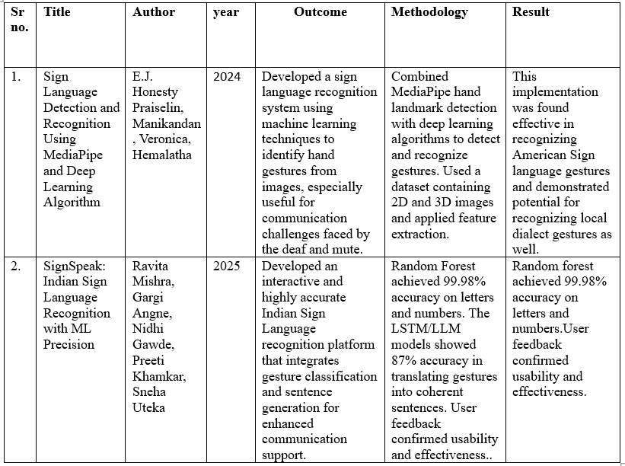
Literature Survey of the existing system

Slide 6
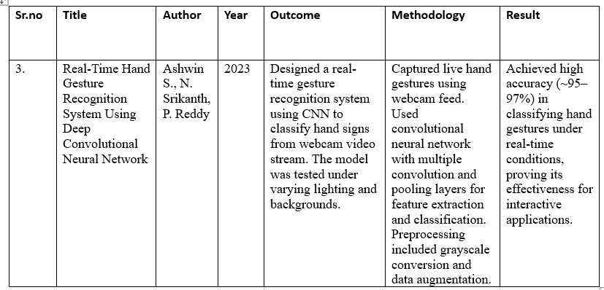
Literature Survey of the existing system

Slide 7
Limitations of existing systems
Our contribution
Limited gesture recognition
No speech output in older systems
Low real-time accuracy
Requires large dataset for better accuracy
Similar hand gestures can cause misclassification

Slide 8
Limitations of existing systems
Limited gesture recognition:
Many traditional systems can recognize only a small set of predefined gestures, restricting practical communication and reducing usability.
No speech output in older systems:
Earlier systems were limited to text output only, which did not provide complete communication support for real-time conversations.
Low real-time accuracy:
Some existing models struggle with real-time prediction due to slower processing speed and poor optimization techniques.

Slide 9
Requires large dataset for better accuracy:
Deep learning-based systems depend heavily on large and diverse datasets, and limited training data can reduce prediction accuracy.
Similar hand gestures can cause misclassification:
Gestures with slight variations in finger positioning often lead to incorrect predictions due to feature similarity.

Slide 10
Problem statement
Problem statement:There is a communication gap between deaf individuals and people who do not understand sign language.Existing systems lack real-time accuracy or special hardware.
Description:Deaf individuals rely on sign language for communication,but most people do not understand it.Thias creates a communication barrier in daily interactions.
Proposed solution:We propose a real-time AI-based system that detects hand gestures using webcam and converts them into text and speech using CNN and mediapipe,enabling smooth communication

Slide 11
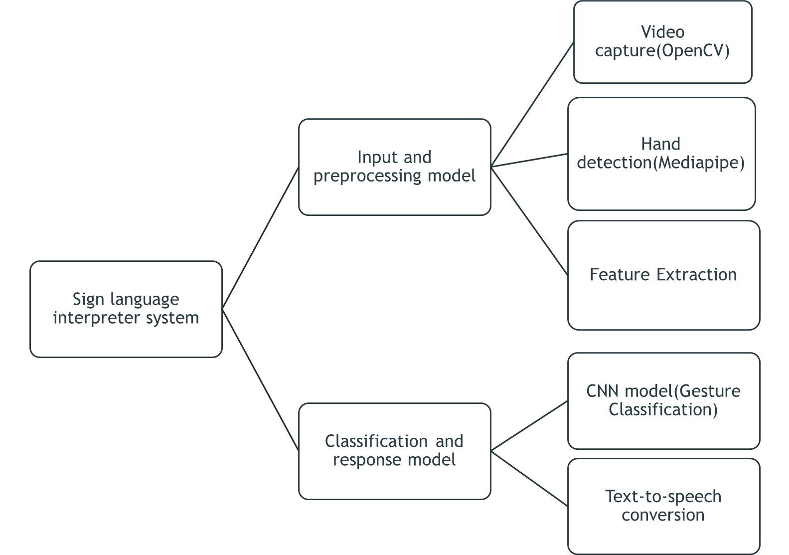
System Design

Slide 12
Technologies and methodologies
Technologies used in sign language interpreter system:
Vs code/pycharm:For coding,debugging, and project development
Programming language:Python-main language used for model development and sytem implementation.
Mediapipe framework:Used for hand detection and landmark extraction.
Tensorflow/keras:Used to build and train the CNN model for gesture classification.
Text-to-speech library(pyttsx3/gTTS):Used to convert predicted text into speech output.

Slide 13
Technologies and methodologies
Methodology:
• Problem Definition:Develop a real-time system to recognize sign language gestures and convert them into text and speech.
• Data Collection:Gesture images are captured using a webcam and organized into labeled datasets for training and testing.
• Preprocessing:Hand region is detected using MediaPipe and unnecessary background noise is removed.
• Feature Extraction:Hand landmarks and important gesture features are extracted for accurate classification.
• Model Training:A Convolutional Neural Network (CNN) model is trained using TensorFlow/Keras to classify gestures.

Slide 14
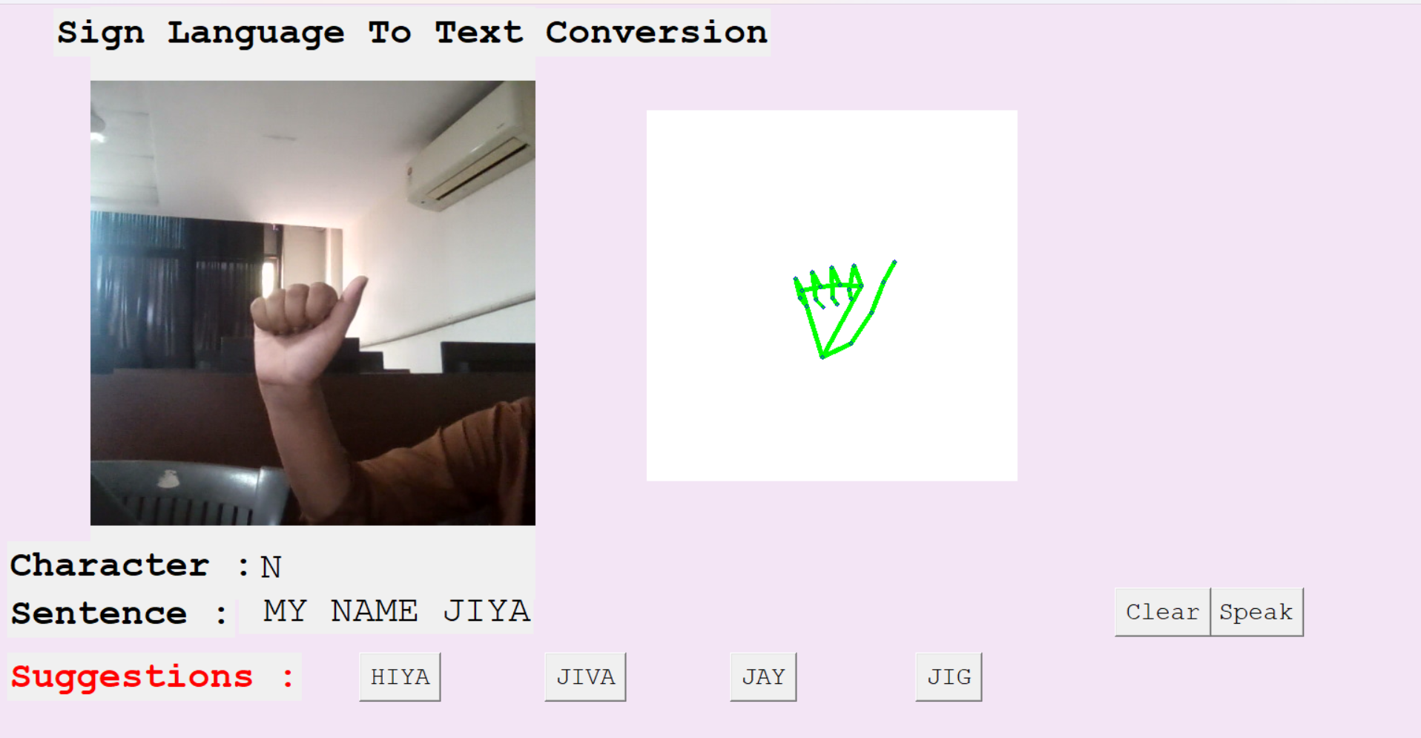
Implementation

Slide 15
Conclusion
The Sign Language Interpreter System provides an effective solution to bridge the communication gap between hearing-impaired individuals and the general public. By integrating computer vision techniques with deep learning models such as CNN, the system is capable of detecting hand gestures, extracting meaningful features, and accurately classifying them in real time. The inclusion of text-to-speech conversion further enhances usability by converting recognized gestures into audible output. Overall, the proposed system improves accessibility, promotes inclusive communication, and demonstrates the practical application of artificial intelligence in assistive technology.

Slide 16
References
IJSRST. Sign Language Detection and Recognition Using MediaPipe and Deep Learning Algorithm. (2024).https://ijsrst.com/index.php/home/article/view/IJSRST52411223
IndJST. SignSpeak: Indian Sign Language Recognition with ML Precision. (2025).https://indjst.org/articles/signspeak-indian-sign-language-recognition-with-ml-precision
Ashwin S., Srikanth N., Reddy P. Real-Time Hand Gesture Recognition System Using Deep CNN. (2023).https://www.ijraset.com/research-paper/sign-language-gesture-detection-using-cnn

Slide 17
Thank You...!!

